Slide 1

libCEED
Community Analysis
Leila Ghaffari
Dec. 2, 2019

Slide 2



Introduction
The CEED API library
The focus is High-order FEM
Provides a portable algebraic interface
Applicable for other numerical methods
Includes optimized implementations for CPU and GPU
Includes library examples (Navier-Stokes, and Shallow Water)

Slide 3
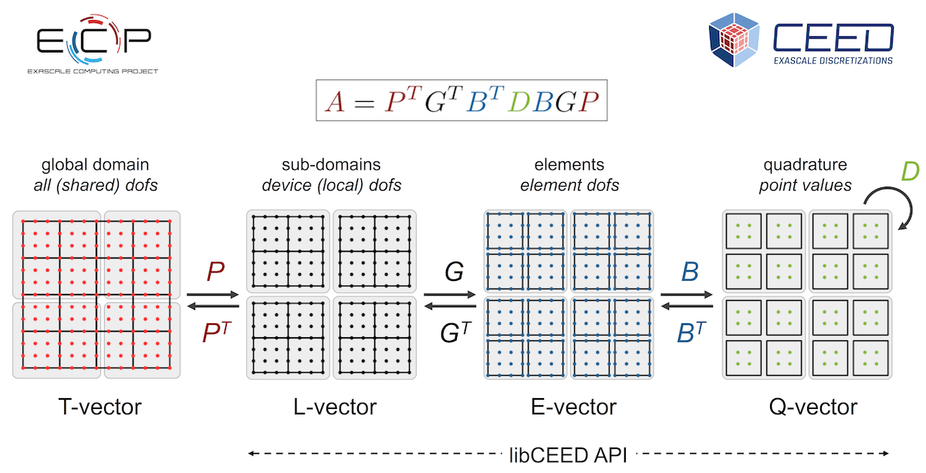

Slide 4
Communication
GitHub issues and PR (Pull Request)
Slack
Commits should be short enough to be traceable for the community.
Commits will be merged after passing tests.

Slide 5
Contribution
Adding a new Navier-Stokes Equations with primitive variables.
Stabilizing current Navier-Stokes Equations by SUPG and SU methods.
Adding an implicit time stepping method to Navier-Stokes Equations.
WIP:
Adding Boundary Integrals.

Slide 6
?

